Slide 1
Introduction to
Git & GitHub
...
Written by Rachel J. Morris, last updated 1/7/17

Slide 2
Contents:
What is source control?
What is Git?
What is GitHub?
How to use GitHub from the web interface
How to use Git & GitHub from the command line

Slide 3

What is Source Control?
What is Source Control and why are you forcing us to use it?

Slide 4
What is Source Control?
What is Source Control and why are you forcing us to use it?
Source Control is a tool that is used by software developers to keep track of changes to their code over time, collaborate with others, and generally manage your code during development with by variety of features.

Slide 5
What is Source Control?
Some more well-known source control solutions are…
TFS, usually in Microsoft shops
Mercurial
Git
SVN (Subversion)

Slide 6
What is Source Control?
Source Storage
When using Source Control, all of your source code is stored on a server.
You can pull down the repository of all your code to any machine (if the server is on the network or online), which makes moving it around between computers easy.

Slide 7
What is Source Control?
Source Updates
When you make changes to your source code, you use the source control software to “commit” your changes, and “push” all your commits to the server.
Any computer that has “cloned” the repository locally will be able to get the latest changes through a simple “pull” command.

Slide 8
What is Source Control?
Source Updates
The source control solution keeps track of changes over time, so you can
View all changes made to the code between commits.
See who changed what code, since it keeps track of who is updating what.
Roll-back your changes to any previous commit in the history of the repository.

Slide 9
What is Source Control?
Source Merging
If multiple people are working with the same repository, you can work on the same code at the same time on your own machines.
The source control solution includes tools that will auto-merge changes to code, or make it easier to manually merge changes.

Slide 10
What is Source Control?
Source Branching
If you want to have multiple versions of your source code, such as if you’re working on a new version but don’t want to overwrite your v1.0, you can make a branch.
Each branch is separate, and you can easily pull code from any branch if you need to switch between versions that you’re working on.

Slide 11
What is Source Control?
Source control is used in professional settings where software is being developed, as well as with open source projects with many contributors.
Even if you’re working solo, source control has a lot of features that will make your programming life easier.

Slide 12


Student Nightmares
I made a change and I broke EVERYTHING! I removed my changes but I can’t get it working again!!!
My computer bit the dust and all my work has been lost!!

Slide 13

Student Nightmares

Slide 14


Git & GitHub
Git is a Source Control solution. It is a software program that you run on your machine, and on the repository server, and provides commands like
“git add”
“git commit”
“git push”
GitHub is a source hosting service. You can create a repository on GitHub and they’ll take care of the server stuff – you just clone the repository on your own machine.
GitHub is free for open source projects.

Slide 15



Source Hosting Services
There are a lot of source hosting websites out there
CodePlex
Usually these are free for open source projects.
Bitbucket has free hosting for private repositories, so long as your team size is 5 or less.

Slide 16
Source Hosting Services
Generally I use GitHub for public stuff and BitBucket for private stuff.
CodePlex
Different hosts only support certain source control solutions – GitHub only does Git, BitBucket does Git and Mercurial, etc.

Slide 17
Getting started with
GitHub

Slide 18
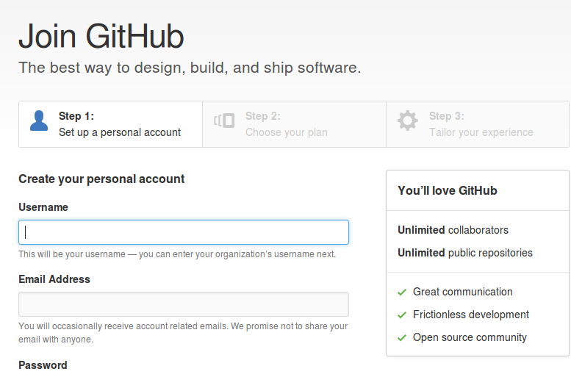
Getting started with GitHub
When you first go to GitHub, you will need to register an account.
You can use a free plan,
which just provides free hosting for public repositories.

Slide 19
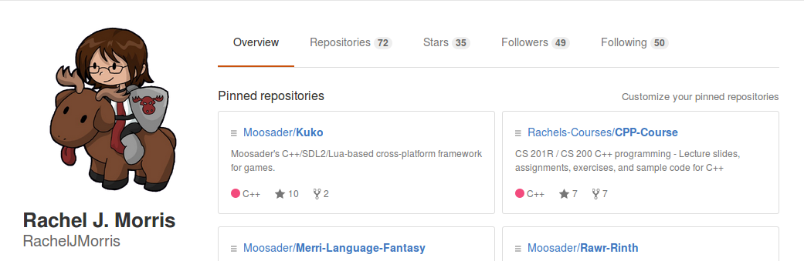
Getting started with GitHub
After you register on GitHub (and confirm your email address), your profile page will be at
GitHub.com/YOUR_USER_NAME

Slide 20
GitHub from the
Web Interface

Slide 21
GitHub from the Web Interface
How to create a new repository…

Slide 22
GitHub from the Web Interface
How to upload code to your repository…

Slide 23
GitHub from the Web Interface
How to edit/create files in your repository…

Slide 24
GitHub from the Web Interface
Viewing commit history…

Slide 25
Command-line Git

Slide 26
Command-line Git
Setting up…
Install Git by going to the main website
https://git-scm.com/
And downloading the version for your operating system.
(If you’re using Linux, install it through your package manager)

Slide 27
Command-line Git
Setting up…
Once installed, to use Git…
Windows:
Right-click in your file explorer and open Git Bash.
Linux:
Open your terminal.

Slide 28
Command-line Git
Setting up…
You will need to set up your config like this:
git config --global user.name "John Doe"
git config --global user.email johndoe@example.com

Slide 29
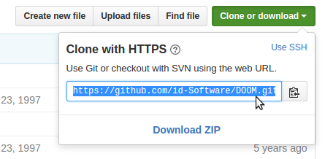
Command-line Git
Cloning a repository…
To clone a repository, go to the repository page from the web interface.
Copy the URL here.
Then in your terminal, make sure you’re in the directory where you want to put the repository.
(You can also clone using SSH, GitHub has a tutorial for that.)

Slide 30
Command-line Git
Cloning a repository…
Type in
git clone
And then paste in the URL of the repository.
(You can also clone using SSH, GitHub has a tutorial for that.)
git clone https://github.com/id-Software/DOOM.git

Slide 31
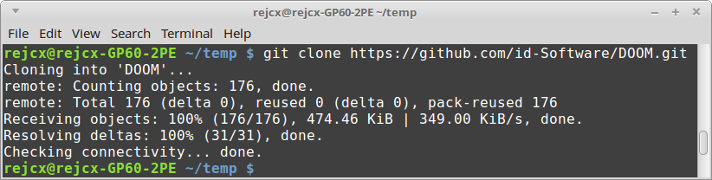
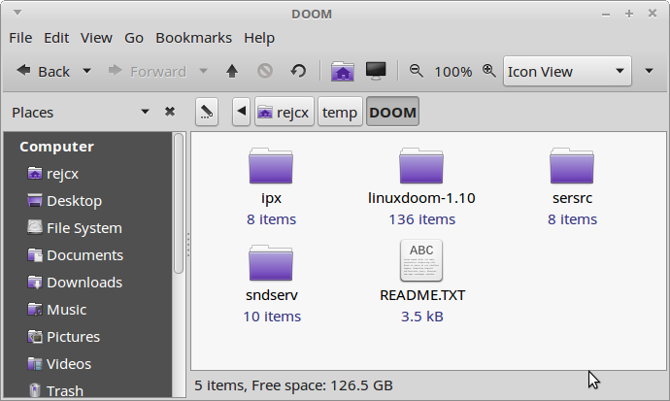
Command-line Git
Cloning a repository…
It will pull down all the files from the repository onto your harddrive.

Slide 32
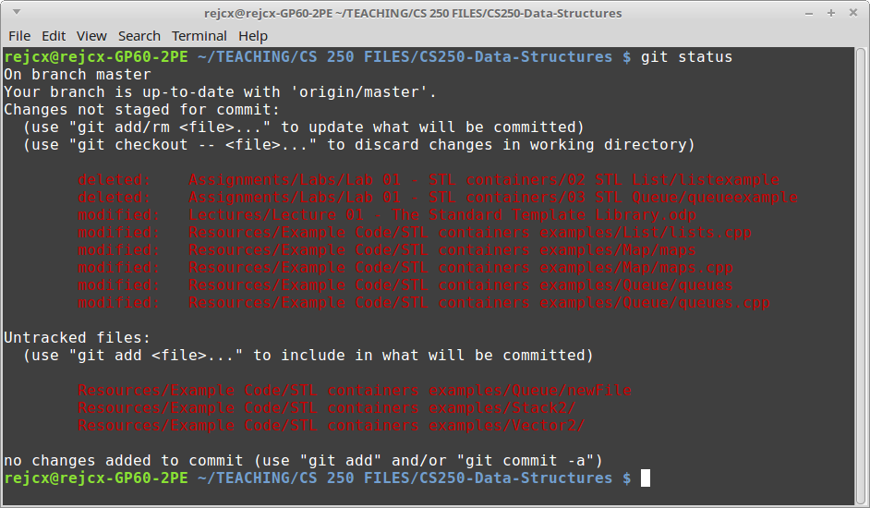
Command-line Git
View the status…
To see what files have been changed, you can use
git status

Slide 33
Command-line Git
Creating a commit
Lets say you pulled down your own repository and want to make some changes.
First, you will add the files that have changed:
You can also use
To add all files
git add sourcefile.cpp
git add .

Slide 34
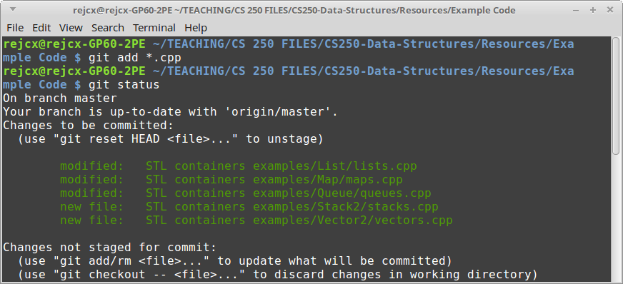
Command-line Git
Creating a commit
After you’ve added your files, check on the status…
git status

Slide 35
Command-line Git
Creating a commit
After you’ve selected all the files that you want as part of this change-set, you will make a commit.
Use -m and add a commit message. If you don’t use the -m message flag, it will open up a text editor for you to put your commit message into.
If it gives you Vi/Vim and you don’t know what to do, type
:q
(enter)
To get out of there…
git commit -m "Fixed bug with user input"

Slide 36
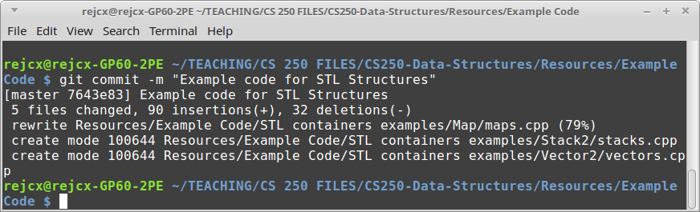
Command-line Git
Creating a commit
The commit will look like this:

Slide 37
Command-line Git
Creating a commit
A commit does not automatically push your changes to the server – you have to use git push for that.
You can get a series of commits ready to go before pushing all your changes to the server as well.
Also, before you pull the latest changes from the server, make sure you commit any work that hasn’t been committed yet!

Slide 38
Command-line Git
Getting changes from the server
If any changes has been made to the repository from another machine, you will want to use git pull to get the latest version of the code.
git pull

Slide 39
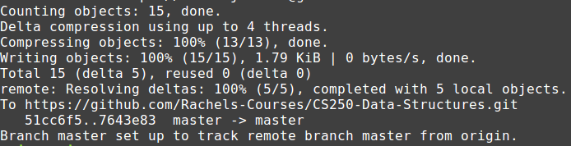
Command-line Git
Pushing changes to the server
After you’ve made your commit(s), push your changes to the server with…
(master is the default branch)
git push -u origin master
This is what a successful push looks like.

Slide 40
Command-line Git
Failed push?!
If your push fails, usually it is because there have been changes made to the repository from another location, and you need to update your local repository before you can push your changes!
Make sure all your current changes are in a commit!
Use git pull
Hopefully it auto-merges…
It will ask for a commit message if it merges.
Do your push again
git pull

Slide 41
Introduction to Git
Those are the basics of what you’ll need to use Git from the command line.
There are also other resources online if you want to use branches or other features of Git.
Get in the practice of using source control on your projects and you’ll wonder how you ever lived without it!

